Slide 1

Case Study
Gonzalo Hernández
Data Scientist
December 2024

Slide 2

My Journey
Professor
Since 14Y ago, I had several teaching experiences from 1-1 school support to University lectures on Design Thinking, Creativity & Product Design
Analytics Consultant
2Y Managing clients and translating requirements into actions
Team Player
Problem Solver
Stakeholder Management
Fast-Changing Environments
Technical Consultant
Led every meeting with cooperatives’ managers, to communicate
and implement governments new projects and improvements
Data Scientist
1.5Y leading R&D Squads, Modelling, Attribution & AI projects for Starbucks, Nestle among others

Slide 3
Today’s topic
A practical use case for Principal Component Analysis

Slide 4
PCA 101
From zero to hero

Slide 5
A non-technical approach
What does PCA do? What can we do with it?
We seek to
Capture the vital information in the data
To visualize or understand it more easily!

Slide 6

A non-technical approach
A 3D ball
What information best describe this ball´s volume?
Can we describe the ball in 2D?

Slide 7

A non-technical approach

Slide 8
A non-technical approach
y
This is what we see from one side
x

Slide 9
A non-technical approach

Slide 10
A non-technical approach
y
And this is from the other
x
Notes:
Ellipse

Slide 11
A non-technical approach
We can now understand with two projections in 2D a volume in 3D!

Slide 12
Technical deep dive
From zero to hero

Slide 13
Fancy definition
“Statistical method that transforms high-dimensional data into a lower-dimensional form”
Identifying new axes, called principal components, along which the data varies the most
These components are orthogonal to each other, meaning they are uncorrelated
Capture the more significant variance

Slide 14
Why we need dimensionality reduction?
Computational Complexity
Difficulty in Visualization
Overfitting and Redundancy
As the number of features increases, the computational resources and time required for analysis and modeling grow exponentially.
It becomes challenging to visualize and understand data in more than three dimensions
Models can become overly complex and fit the noise in the data.
Some features may be highly correlated.
Notes:
Computational Complexity: As the number of features increases, the computational resources and time required for analysis and modeling grow exponentially.
Overfitting: Models can become overly complex and fit the noise in the data, leading to poor generalization on new, unseen data.
Difficulty in Visualization: It becomes challenging to visualize and understand data in more than three dimensions.
Redundancy: Some features may be highly correlated, meaning they convey similar information. This redundancy can be eliminated without significant loss of information.

Slide 15
Math and steps
Data Standardization
Covariance Matrix
Eigenvalue and Eigenvector Calculation
Sorting Eigenvalues and Eigenvectors
Selecting Principal Components
Data Projection (Data * Eigenvector Matrix)
Ongoing PCA
Notes:
Step 1: Data Standardization
Standardization ensures that all features have equal importance in the analysis.
Step 2: Covariance Matrix
The covariance between two variables measures how they change together.
Step 3: Eigenvalue and Eigenvector Calculation
The next step is to compute the eigenvalues and eigenvectors of the covariance matrix. These eigenvalues represent the amount of variance explained by each eigenvector (principal component). Eigenvalues and eigenvectors are mathematical concepts related to linear transformations and matrices. In the context of PCA, they play a central role in identifying the principal components. Here’s what they mean:
Eigenvalue: An eigenvalue (λ) represents a scalar that indicates how much variance is explained by the corresponding eigenvector. In PCA, eigenvalues quantify the importance of each principal component. They are always non-negative, and the eigenvalue corresponding to a principal component measures the proportion of the total variance in the data explained by that component.
Eigenvector: An eigenvector (v) is a vector associated with an eigenvalue. In PCA, eigenvectors represent the directions along which the data varies the most. Each eigenvector points in a specific direction in the feature space and corresponds to a principal component. Eigenvectors are typically normalized, meaning their length is 1.
Step 4: Sorting Eigenvalues and Eigenvectors
To identify the most significant principal components, sort the eigenvalues in descending order. The corresponding eigenvectors are also sorted accordingly. The first principal component explains the most variance, the second explains the second most, and so on.
Step 5: Selecting Principal Components
Choose a subset of the top k eigenvectors to form a transformation matrix. After computing the eigenvalues and eigenvectors of the covariance matrix, they are sorted in descending order based on the magnitude of their eigenvalues. The principal components are then selected from the top eigenvectors. The first principal component corresponds to the eigenvector with the largest eigenvalue, the second principal component corresponds to the eigenvector with the second-largest eigenvalue, and so on. These principal components are orthogonal, meaning they are uncorrelated. This matrix is used to project the original data into a lower-dimensional space, resulting in the reduced dataset.
Matriz standarizada Z

Slide 16
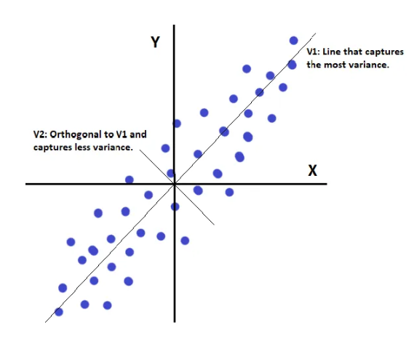
Math and steps

Slide 17
Image’s embeddings visualization
Use case

Slide 18
Pipeline
Everyday, we scraped a news portal for the top 10 news
We asked OpenAI API to make a summary of each one
The images were displayed daily in website to be voted
The summary was sent to Stable Diffusion API alongside with art style
CTR was calculated and stored alongside with images metadata
We tried to predict CTR of new images
Notes:
Pintura al oleo: Oil painting.
Dibujo: Drawing
Realistic high definition photo:

Slide 19
The project
Predict ctr base on data from Ads and it’s embeddings.
Embedding model: text-similarity-ada-001 (1024 dimensions)
Need to visualize them in 3D in order to interpret and get insights (Dim. Reduction from 1024 to 3)
No need of standardization
Simple call to OpenAI API:
  response = openai.Embedding.create(
input=text,
model="text-similarity-ada-001")

Slide 20
The PCA code
# Import PCA class
from sklearn.decomposition import PCA
# Create a PCA instance
pca = PCA(n_components=3) # Specify the number of components
# Fit PCA to the standardized data
pca.fit(data_std)
# Transform the data into the reduced dimensionality
data_pca = pca.transform(data_std)
# The principal components
components = pca.components_
# Explained variance ratio
explained_variance_ratio = pca.explained_variance_ratio_

Slide 21
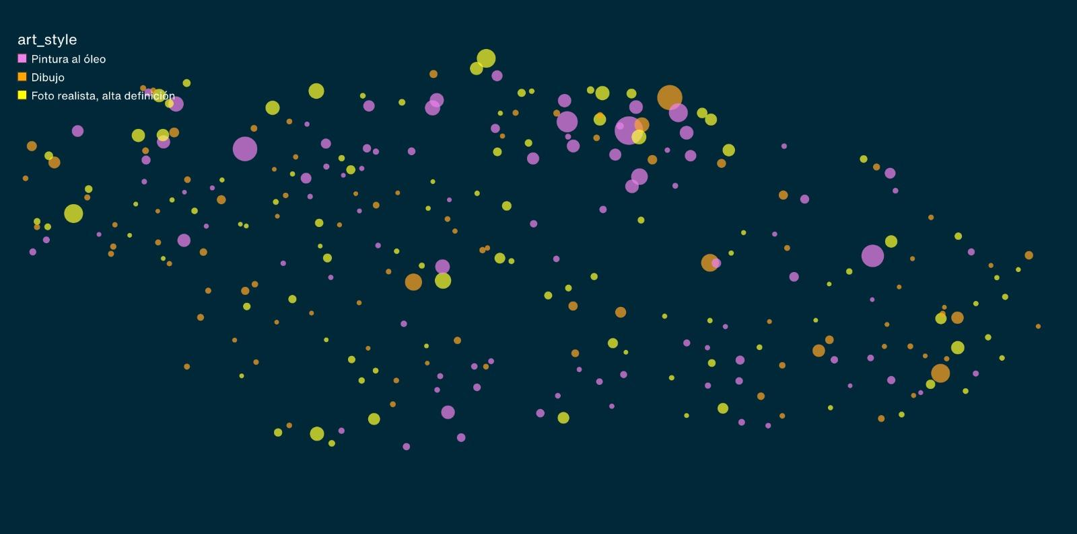
The viz

Slide 22
Thank you!
I will be happy to answer your questions at:
gonzalohernandez1990@gmail.com

